Slide 1
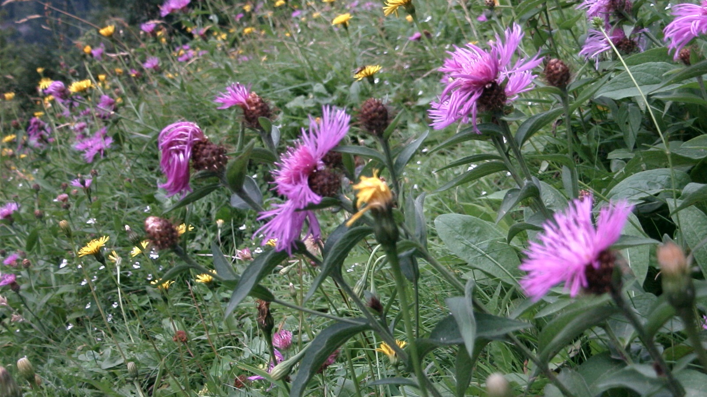
Wild Flower

Slide 2
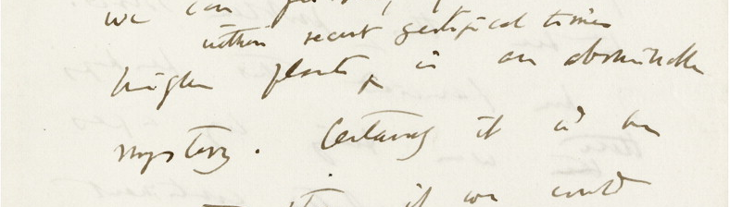
Darwin’s “abominable mystery”
Letter from Darwin to Joseph Hooker, 1879
See: http://www.amjbot.org/content/96/1/5.full
First fossil flowers – mid cretaceous (~100 MYa late dinosaur)
Already high diversity
So, how did they evolve?
http://www.bbc.co.uk/earth/story/20141017-how-flowers-conquered-the-world

Slide 3
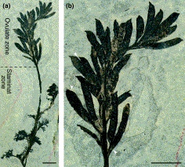
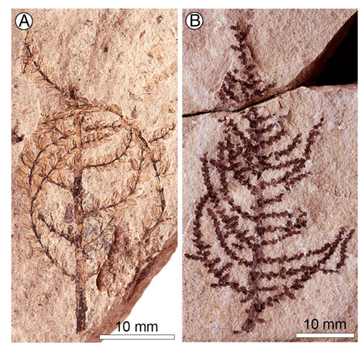
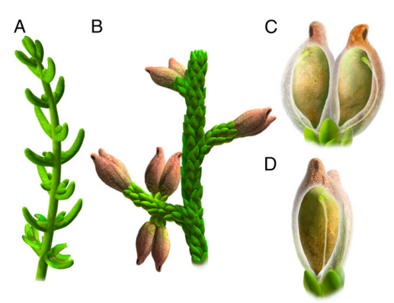
Earliest Fossil Flowers
Archaefructus ~125 Mya
From Chinese fossils
Aquatic
Elongated “flowers”; no petals; male parts below female parts
http://dx.doi.org/10.1126/science.1069439
Montsechia ~130 Mya
From fossils in Spain
Aquatic plant
www.pnas.org/cgi/doi/10.1073/pnas.1509241112
For more discussion see: https://www.nature.com/articles/nplants201715

Slide 4
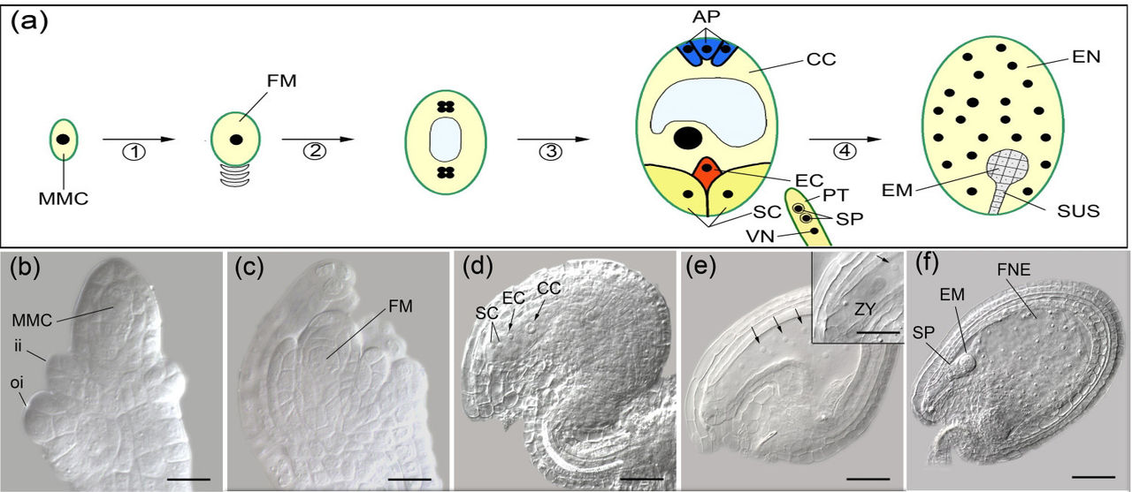
Angiosperm innovations: Double Fertilisation
CC BY 2.0, https://commons.wikimedia.org/w/index.php?curid=15780731
See also: https://youtu.be/bUjVHUf4d1I
Gnetophytes have double fertilisation

Slide 5
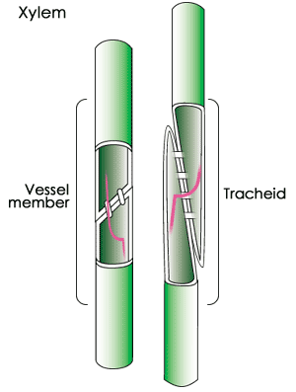
Angiosperm innovations: Vessels
Gymnosperms – tracheids:
narrow hollow cells
overlapping ends allow for water to flow
Angiosperms – also xylem vessels
Wider, better contact between cells so better water flow
But… more prone to embolisms (air bubbles)
[Also differences in phloem]
Gnetophytes have vessels like angiosperms

Slide 6
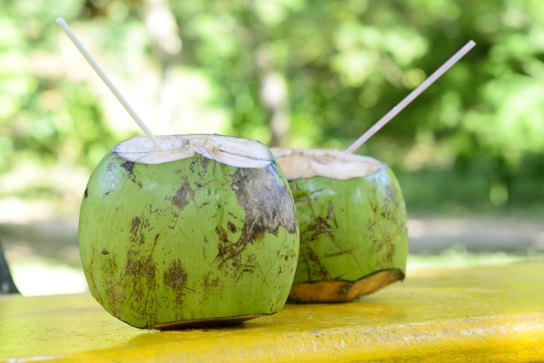
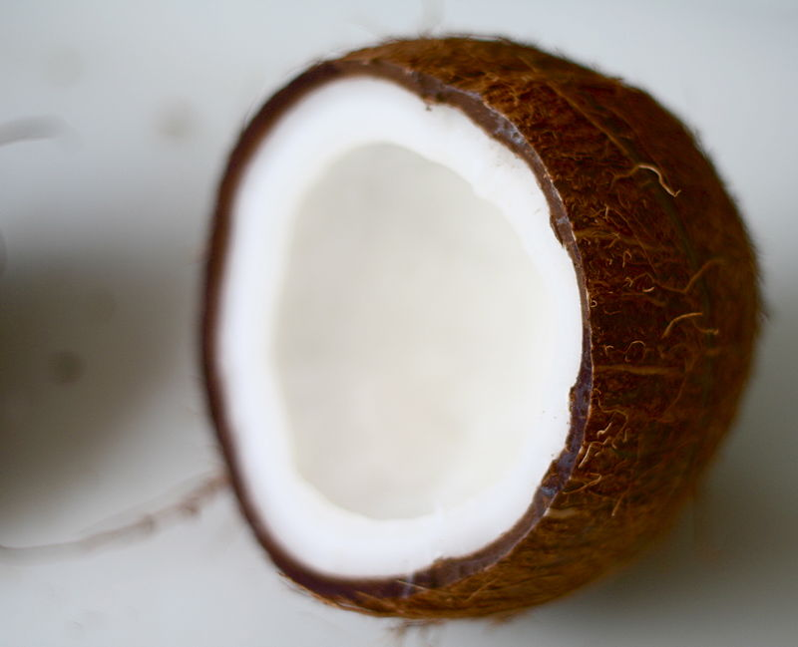
The Angiosperms – Cased Seeds
Ovary protects the seed
Formed from maternal tissues
Endosperm – storage tissue Feeds embryo but…
Gymnosperms have storage
Advanced angiosperms (e.g. orchids – no storage
By Fir0002 - Own work, GFDL 1.2, https://commons.wikimedia.org/w/index.php?curid=202664
Greatest innovation - Flowers

Slide 8
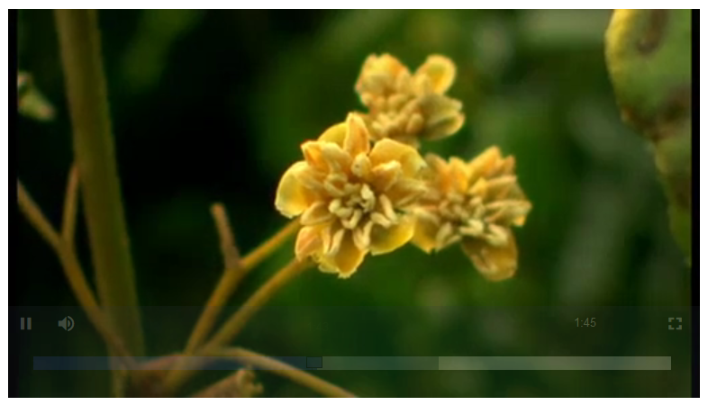
Any Amborellas?
https://learningonscreen.ac.uk/ondemand/index.php/clip/102364
3:50

Slide 10
Flower Evolution

Slide 11
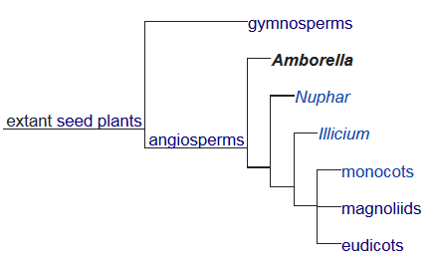
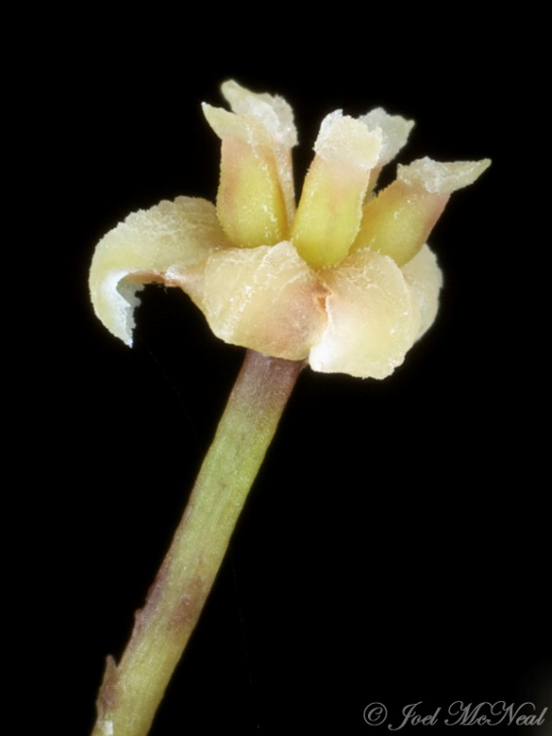
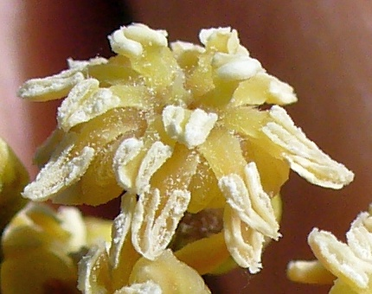
Amborella trichopoda – the basal angiosperm?
Has no vessels only tracheids
But has flowers
Shown by sequencing to be most basal plant
(see: http://science.kennesaw.edu/jmcneal7/plantsys/basals.html)
https://en.wikipedia.org/wiki/Amborella
Dioecious – separate male and female plants
(developmentally determined)
Females may have staminodes (infertile stamens) – evolved from bisexual flower?
CC BY 2.0, https://commons.wikimedia.org/w/index.php?curid=10196277
http://science.kennesaw.edu/jmcneal7/plantsys/basals.html#amborella

Slide 12
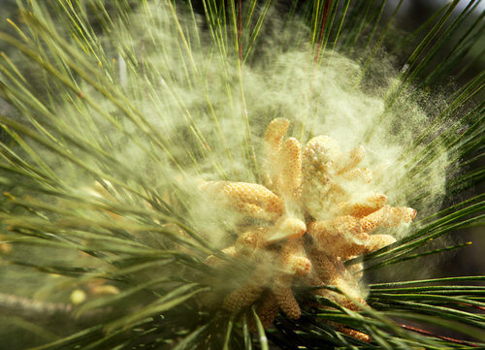
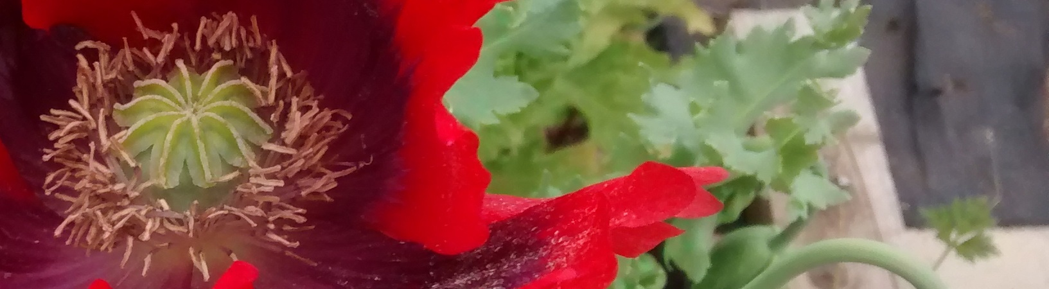
Key steps in flower evolution
Gymnosperms: Male and female cones
Pollen spread by wind –
Uncontrolled; risk of selfing/hybridisation
Pollen stolen by insects
Angiosperms: Male and female organs come together
So… pollen carried to female organ
But… increased risk of self pollination
and… hybridisation still possible

Slide 13
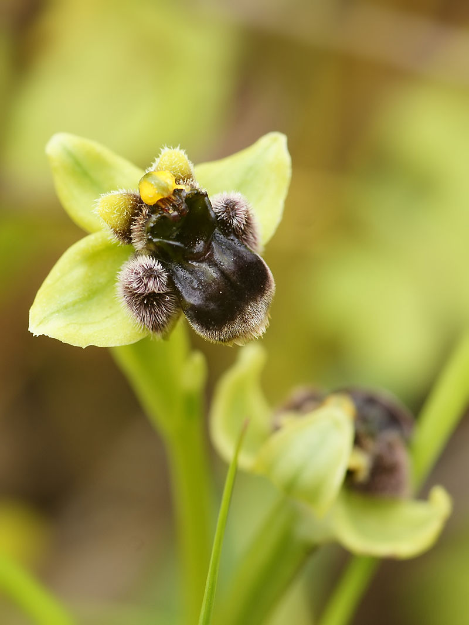
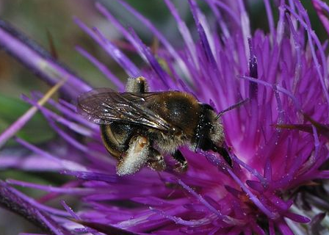
Specialisation!
Co-evolution of plants and animals allows special relationships
Increased diversity of both groups
e.g.Ophrys bombyliflora
(Bumblebee orchid)
Eucera cinnamomea
By Gideon Pisanty (Gidip) - Own work, CC BY 3.0, https://commons.wikimedia.org/w/index.php?curid=17842883
By © Hans Hillewaert /, CC BY-SA 3.0, https://commons.wikimedia.org/w/index.php?curid=6591781

Slide 14
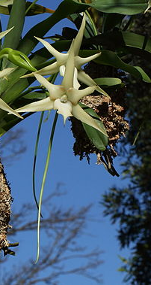
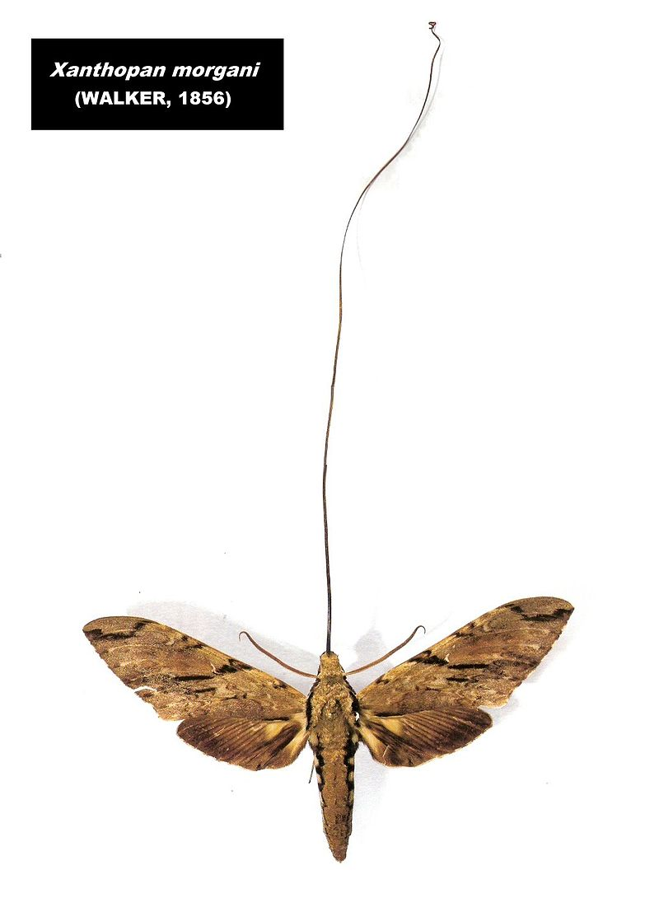
Angraecum sesquipedale – Darwin’s Orchid
By Esculapio - Own work, CC BY-SA 3.0, https://commons.wikimedia.org/w/index.php?curid=9856527
Xanthopan morganii
By Wilferd Duckitt from Darling,, CC BY 2.0, https://commons.wikimedia.org/w/index.php?curid=42036024

Slide 15
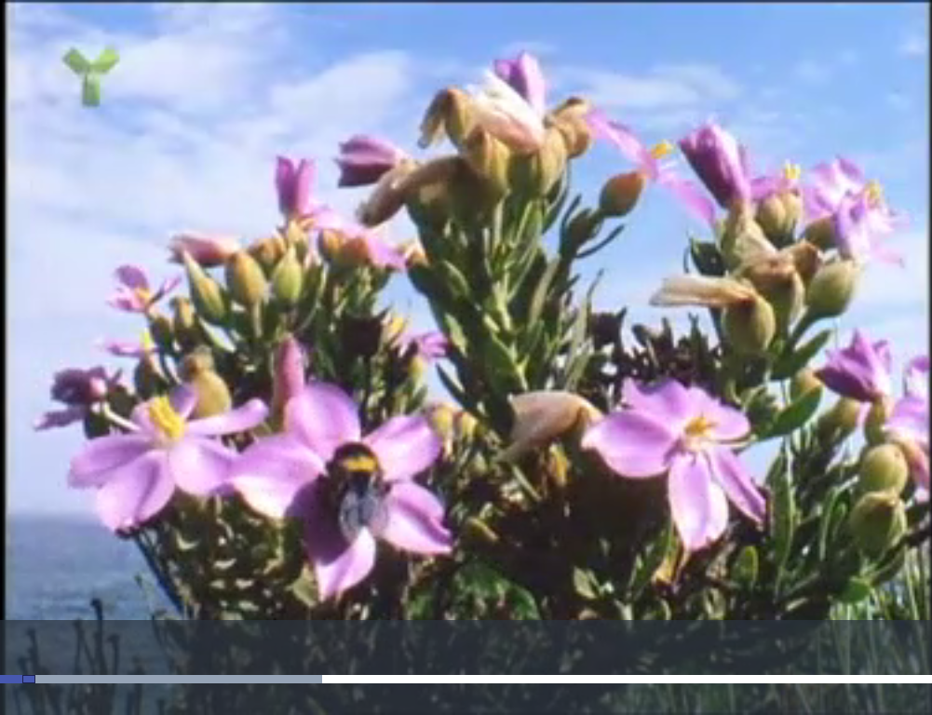
Orphium frutescens
Relationship with Carpenter Bees
David Attenborough - https://learningonscreen.ac.uk/ondemand/index.php/clip/102363 2:35
Iain Stewart - https://learningonscreen.ac.uk/ondemand/index.php/clip/102366 3 mins

Slide 17
It ain’t all flowers

Slide 18
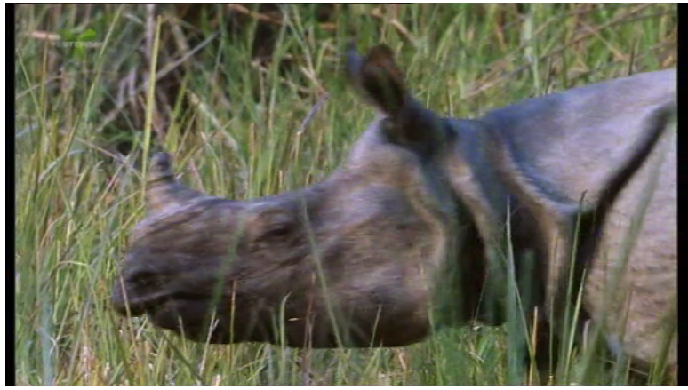
Evolution of “Fruit”
Not exclusively angiosperm (e.g. yew, juniper)
but most common in this group
Various developmental origins
Designed to be eaten
Resistant seeds tolerate gut environment
Spreads seeds
Germination with fertiliser
https://learningonscreen.ac.uk/ondemand/index.php/clip/102388 2:00

Slide 19
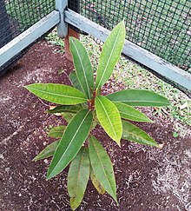
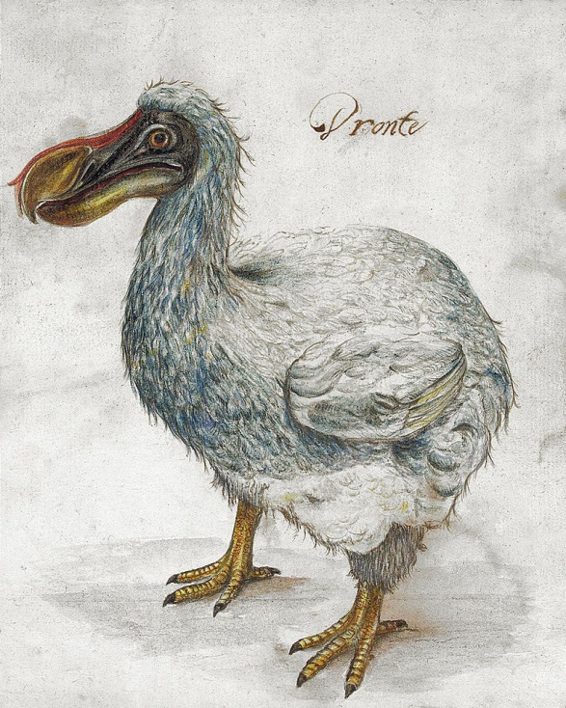
Sideroxylon grandiflorum
Tambalacoque
Native tree of Mauritius
Apricot like fruit
1973 – Stanley Temple claimed only 13 trees
All ~300 years old
The Dodo – last see 1662
Seeds abraded by dodo gizzard
(n.b. probably not true)
https://stories.rbge.org.uk/archives/19390

Slide 20
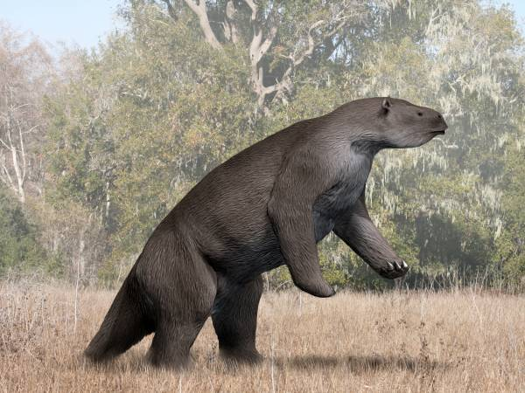
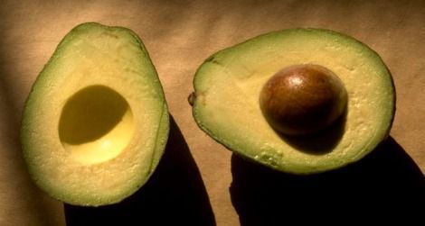
Megatherium – Giant Sloth
https://www.smithsonianmag.com/arts-culture/why-the-avocado-should-have-gone-the-way-of-the-dodo-4976527/

Slide 22
Spread of the Angiosperms

Slide 23
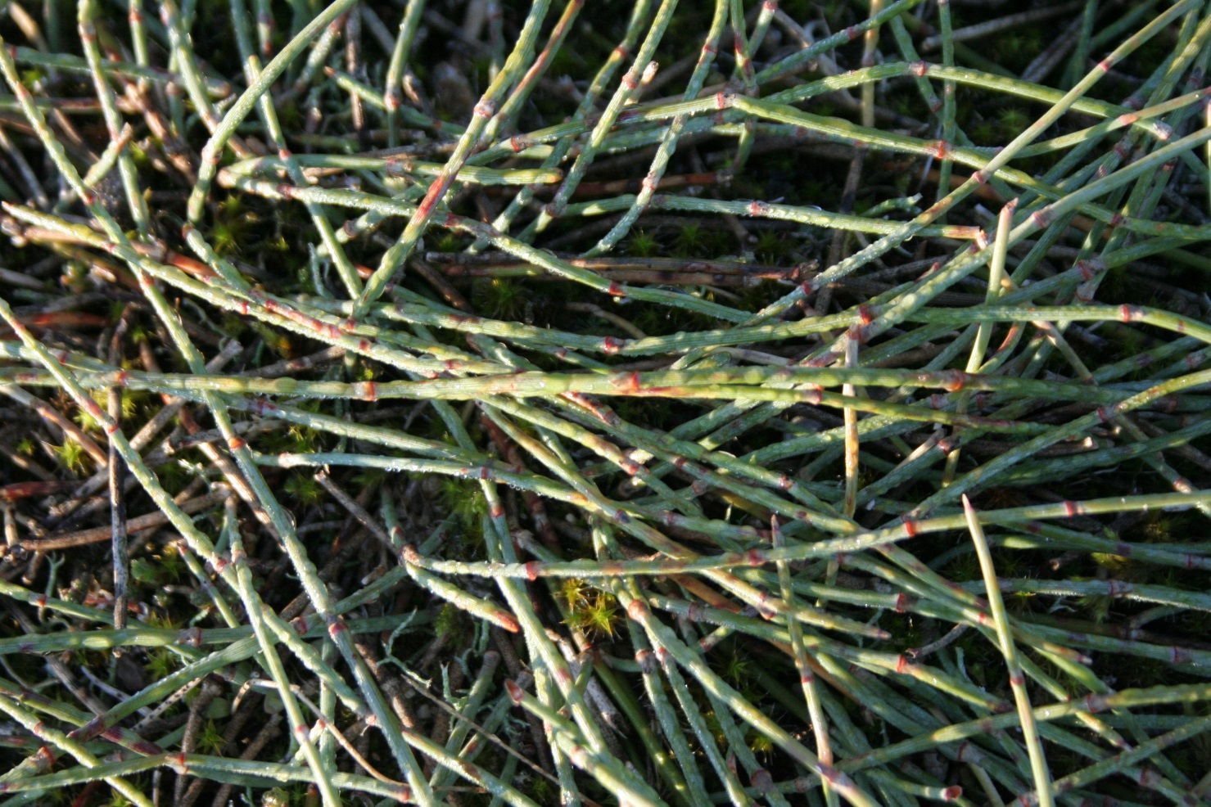
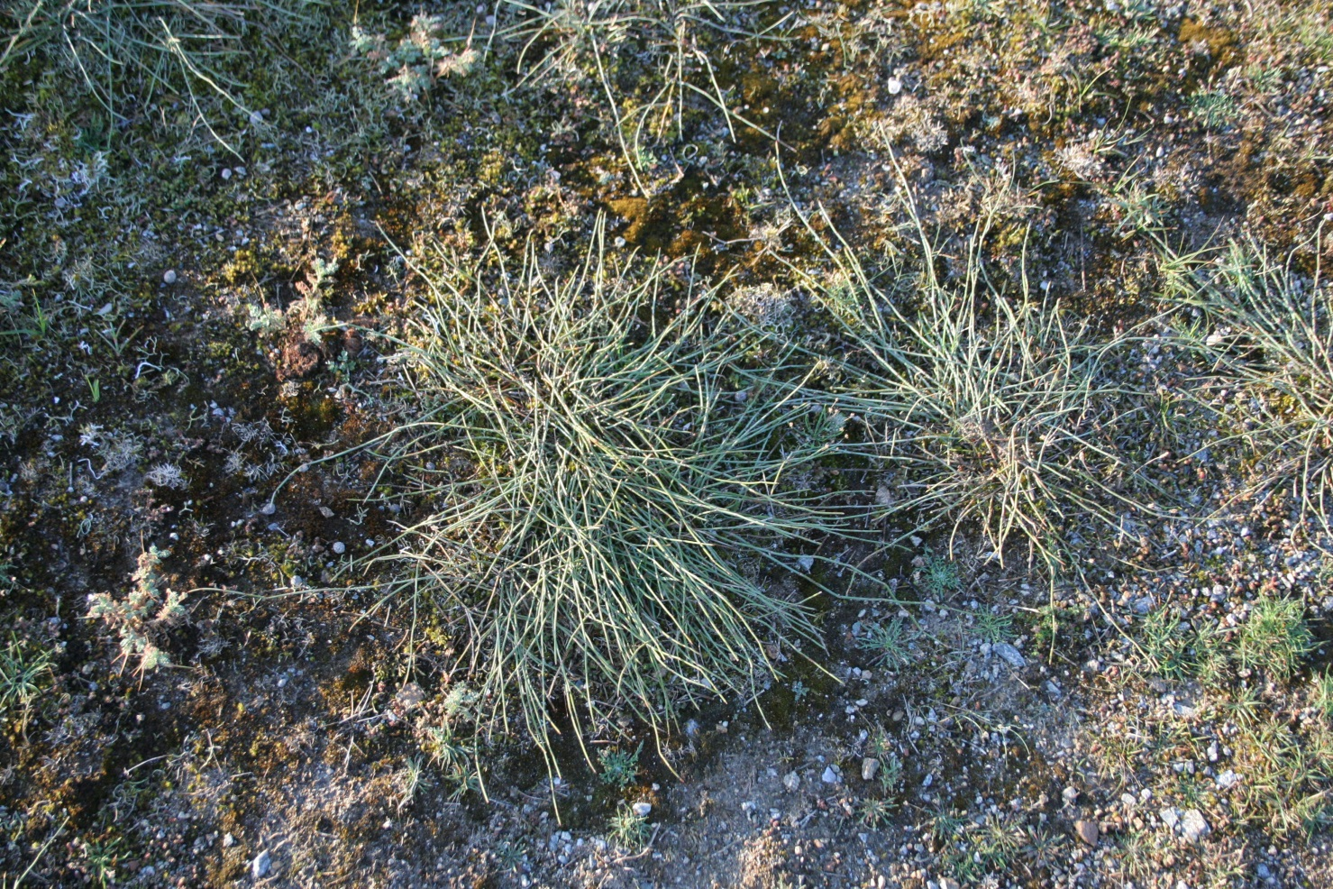
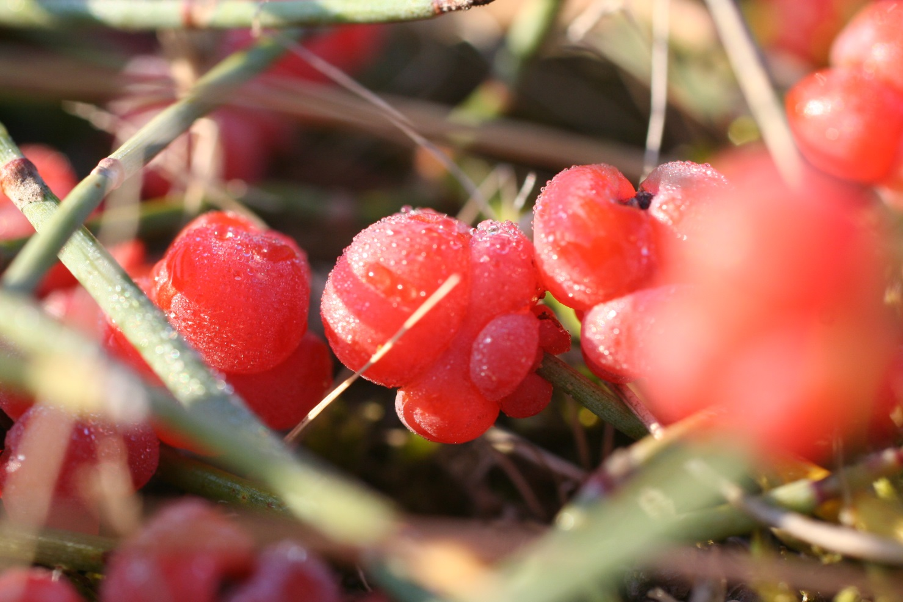
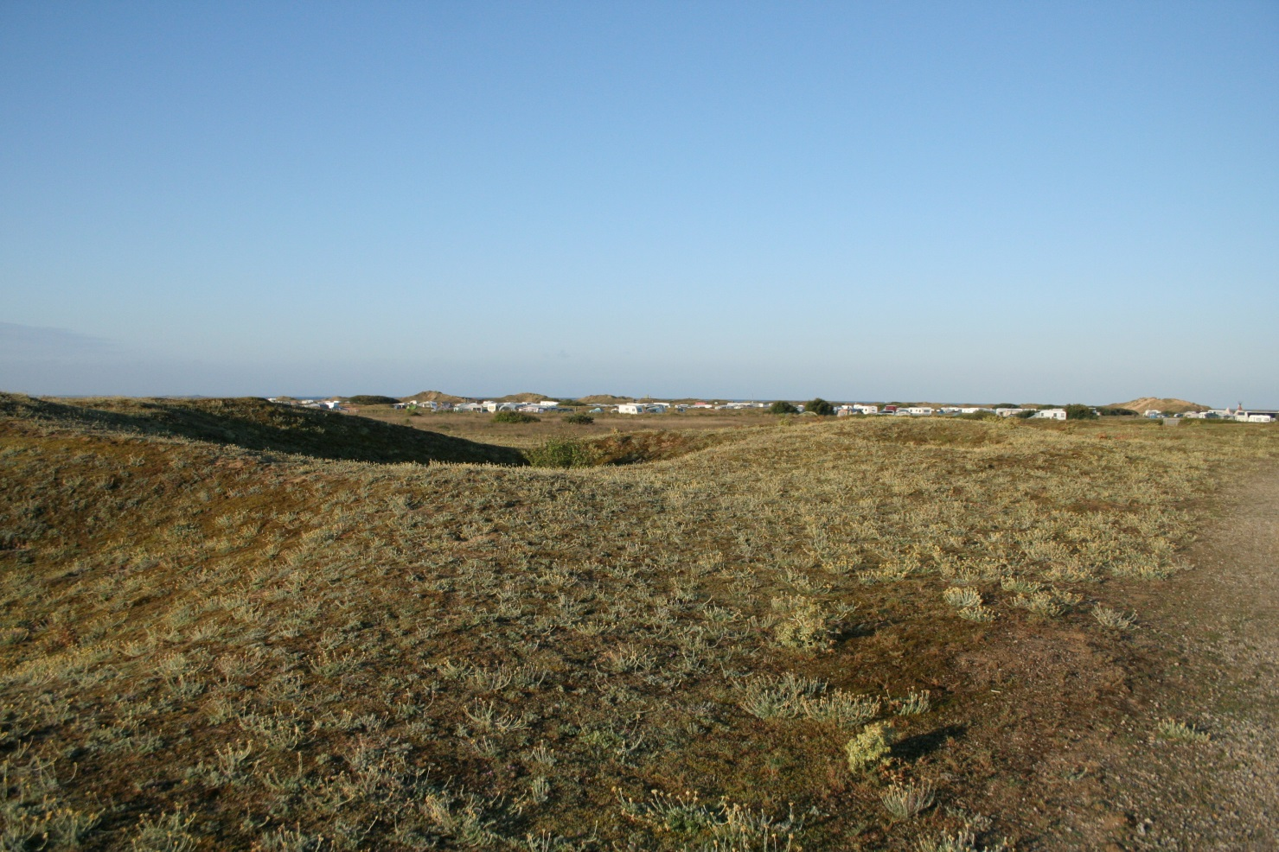
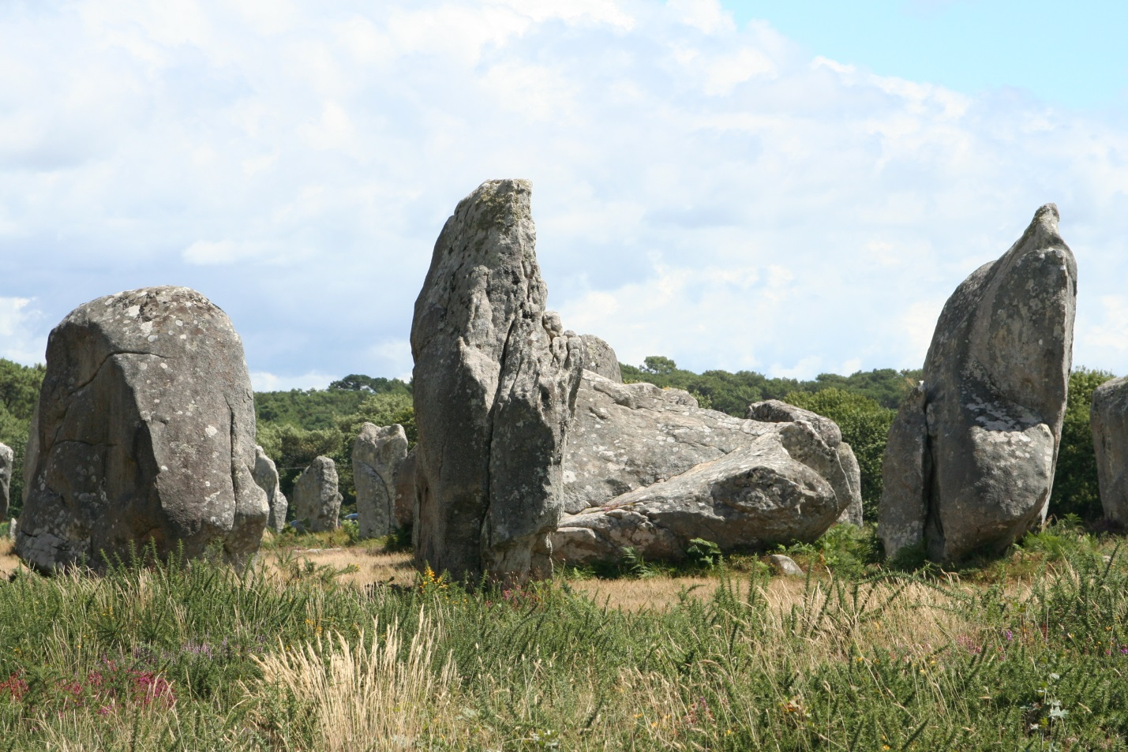
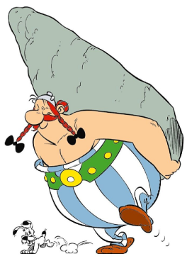
What I did in my summer holidays…
Carnac - Brittany
Ephedera distachya
Raisins de Mer
NOT grass but fills same niche
Almost a HERB

Slide 24
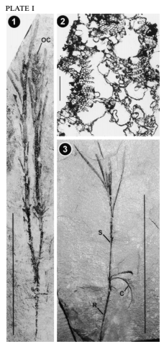
What is a “Herb”
Herb = plant with soft tissues only
No secondary thickening
May die down in winter
Maybe be annual…
biennial…
perennial…
No extant gymnosperm herbs
Possible fossil - Aethophyllum
(but maybe woody…)

Slide 25
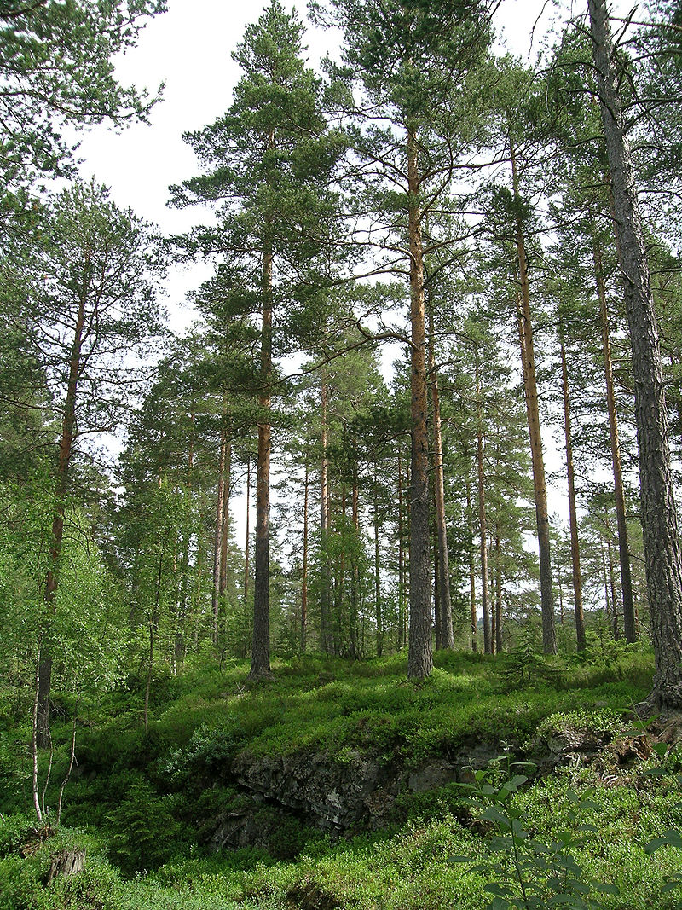
Being Woody…
Pros
Can grow TALL
(competition for light)
Resilient
…
Cons
Expensive
Inflexible
…
, https://commons.wikimedia.org/w/index.php?curid=942983
Many angiosperms have lost ability to produce wood and adopted alternative growth forms

Slide 26
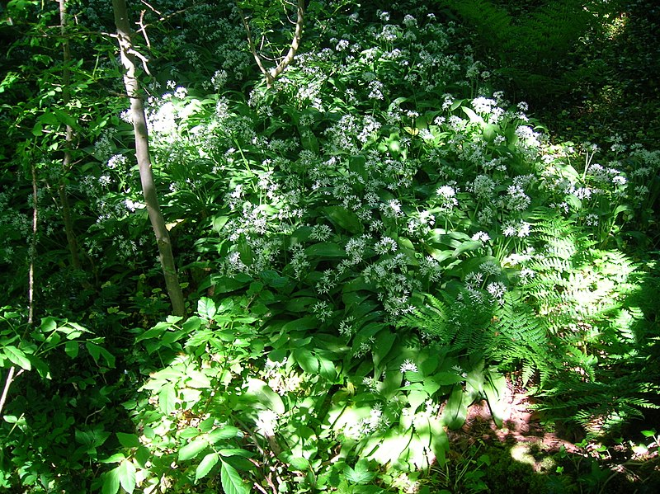
The Understorey
Low Light = Low Energy
Transient light:
Seasonal (spring flowers)
Lightflecks
Needs efficiency
Low wind –
limits wind pollination
Angiosperms could (finally) compete with non-seed plants!

Slide 27
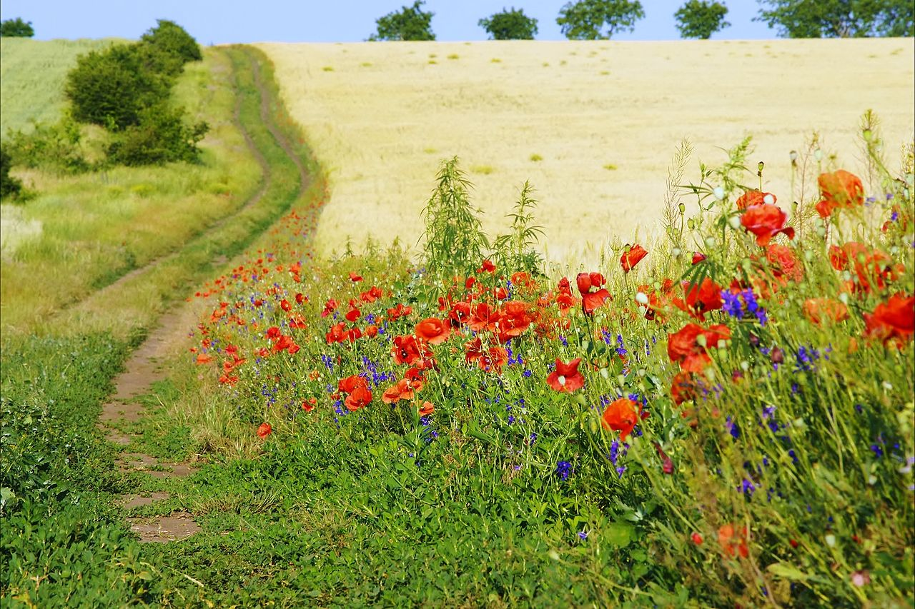
Ephemerals – live fast die young
Weed species – short lived (usually annual plants)
Exploit transient gaps in ecosystems
Naturally – tree fall
Human influence – fields
Exploit DISTURBANCE

Slide 28
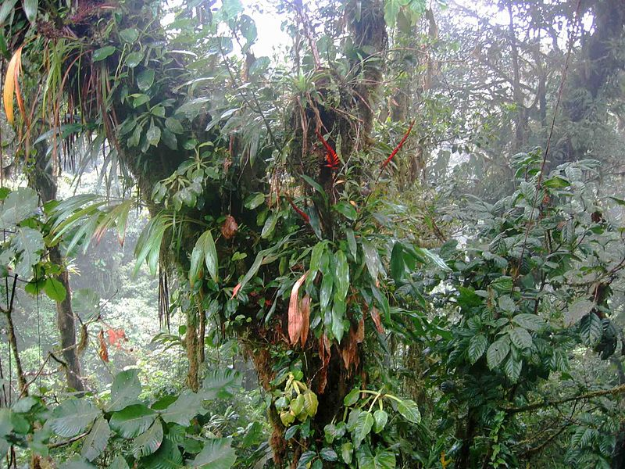
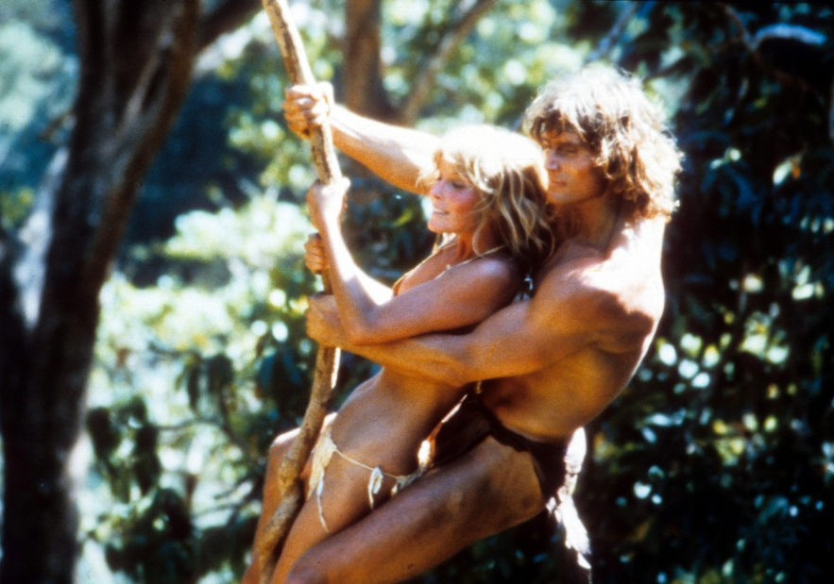
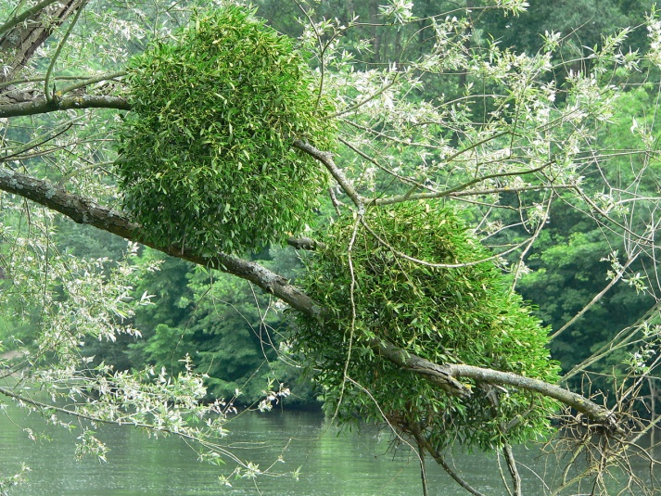
Cheating you way to the Canopy
Epiphytes:
Height without wood
…but limited resources
Climbers:
Attached to ground but get height without making a trunk
Hemiparasites:
Steal from your host

Slide 29
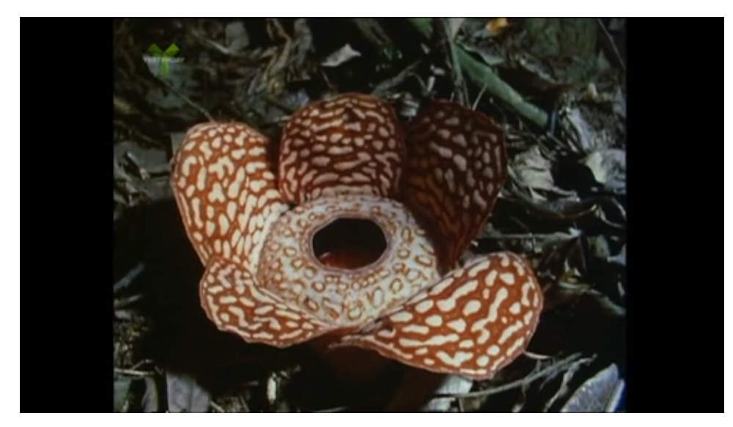
Doing without Light
https://learningonscreen.ac.uk/ondemand/index.php/clip/104150
(6: 56 Dodder to 3:40 then Rafflesia)
Parasites take all resources from host plant

Slide 31
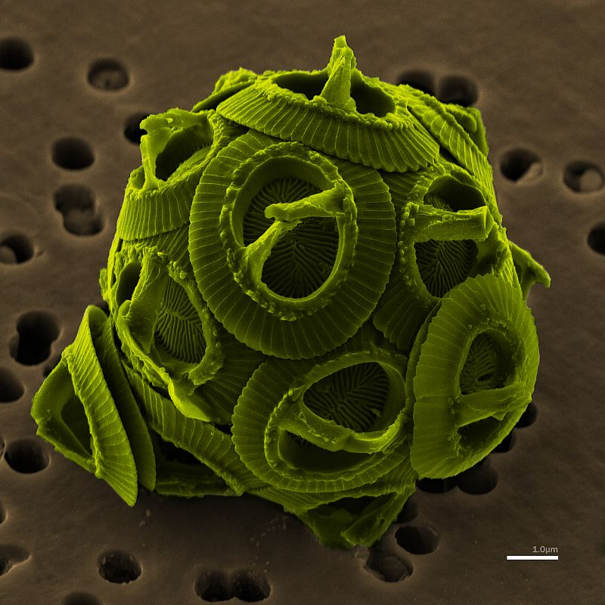
Sea of Green

Slide 32
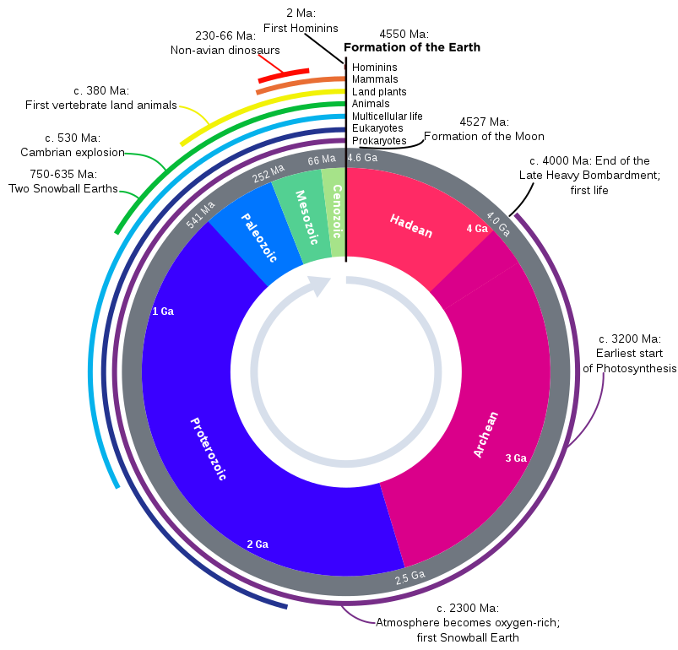
Phytoplankton – feeding the oceans since 3 000 000 000 BC
Secondary Symbiosis
Multiple events leading to different algal groups
Photosynthesis
Primary symbiosis
Green algae
Red algae
Glaucophytes
Cyanobacteria - oxygen

Slide 33
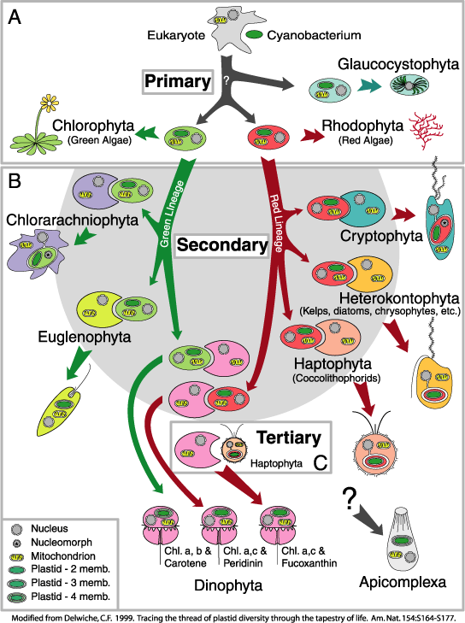
The Cast…
Archaeplastida
http://bioinformatica.uab.es/biocomputacio/treballs00-01/torres-vela/WEB/800/GIFS/endosymbiosis.gif

Slide 35
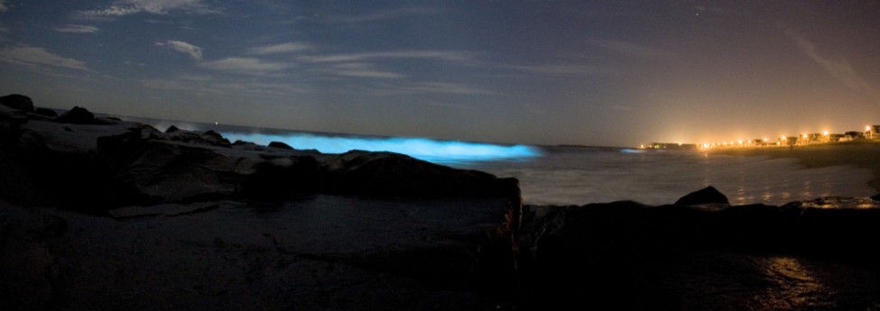
Bioluminescence
Thought to protect against predation –
Confuses predators
May attract predators’ predators
luciferin + O₂ ⇌ luciferin-ox + H₂O + LIGHT
https://learningonscreen.ac.uk/ondemand/index.php/clip/151606

Slide 37
Meet the Cast

Slide 38
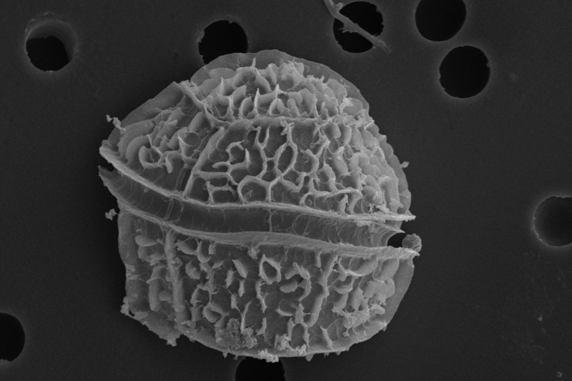
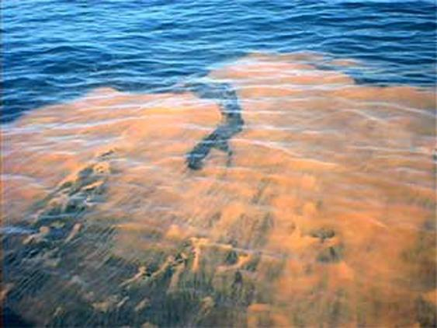
The Cast…
Dinoflagellates
Appeared in Triassic
May be heterotropic or
autotropic (or mixo-)
May have cellulose cell
wall – host cell is an alga
May be secondary or tertiary endosymbiosis
Usually from rhodophytes but no phycobillisomes
Contain chlorophyll a and c + carotenoids
Cause “Red Tides”
By Nicola Angeli/MUSETCC BY-SA 3.0, https://commons.wikimedia.org/w/index.php?curid=48309073

Slide 39
The Cast…
Coccolithophores
In the group Haptophyta
Upper Triassic
Probably from Rhodophytes
Brown chloroplasts – Chl a & c and fucoxanthin
Calcium carbonate shell
Photo by NEON ja, colored by Richard Bartz - Own work, CC BY-SA 2.5, https://commons.wikimedia.org/w/index.php?curid=6072505

Slide 40
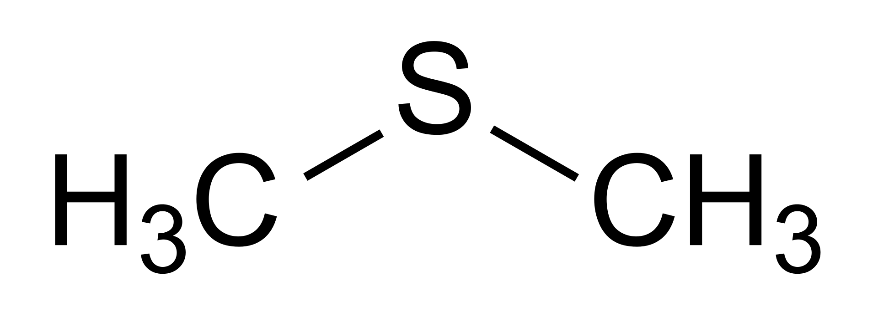
Climate effects
Dimethyl sulphide (DMS- the smell of the sea)
Seeds cloud formation, cooling feedback

Slide 41
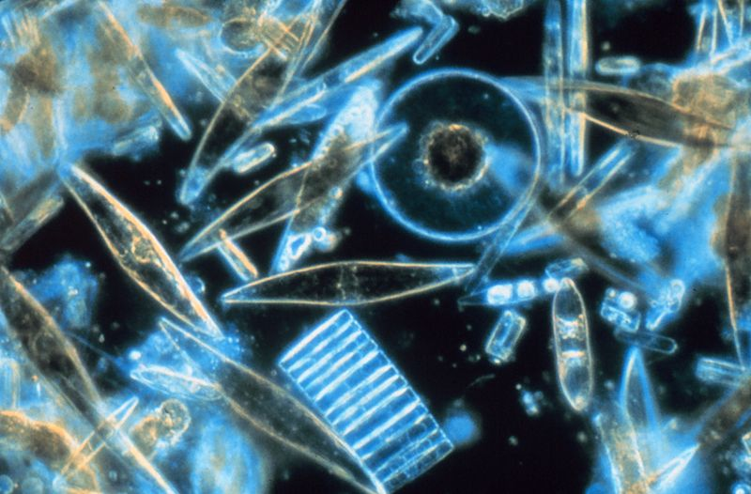
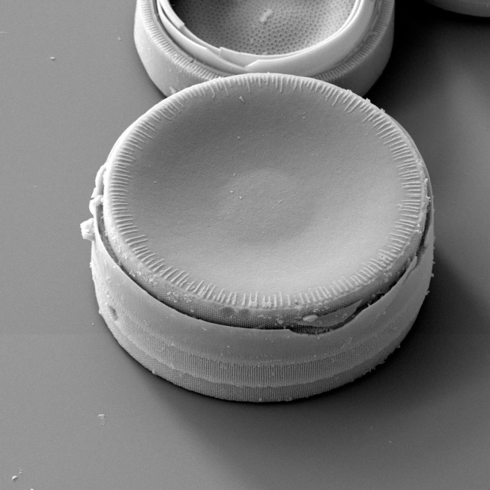
The Cast…
Diatoms
Jurassic (or earlier)
Non motile (but may float)
Silica “shell” in two parts
4 chloroplast membranes
In group Heterokonta
From Rhodophytes
Chl a and fucoxanthin but no chl b or phycobilisomes
By Prof. Gordon T. Taylor, Stony Brook University, https://commons.wikimedia.org/w/index.php?curid=246319

Slide 43
Let it Snow

Slide 44
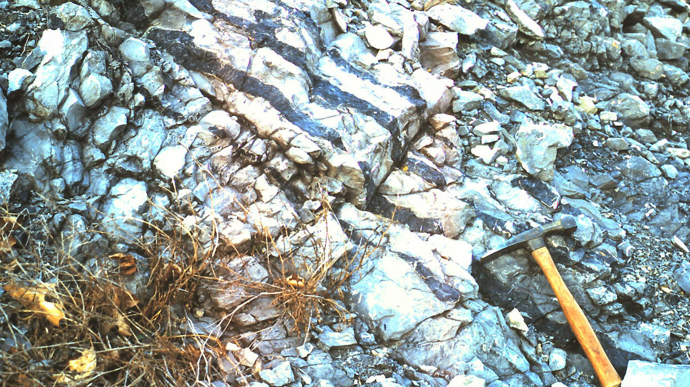
Marine Snow
Diatoms form diatomaceous chert (silica)
(Most cherts are of biological origin)
Read all about chert at https://www.wikiwand.com/en/Chert

Slide 45
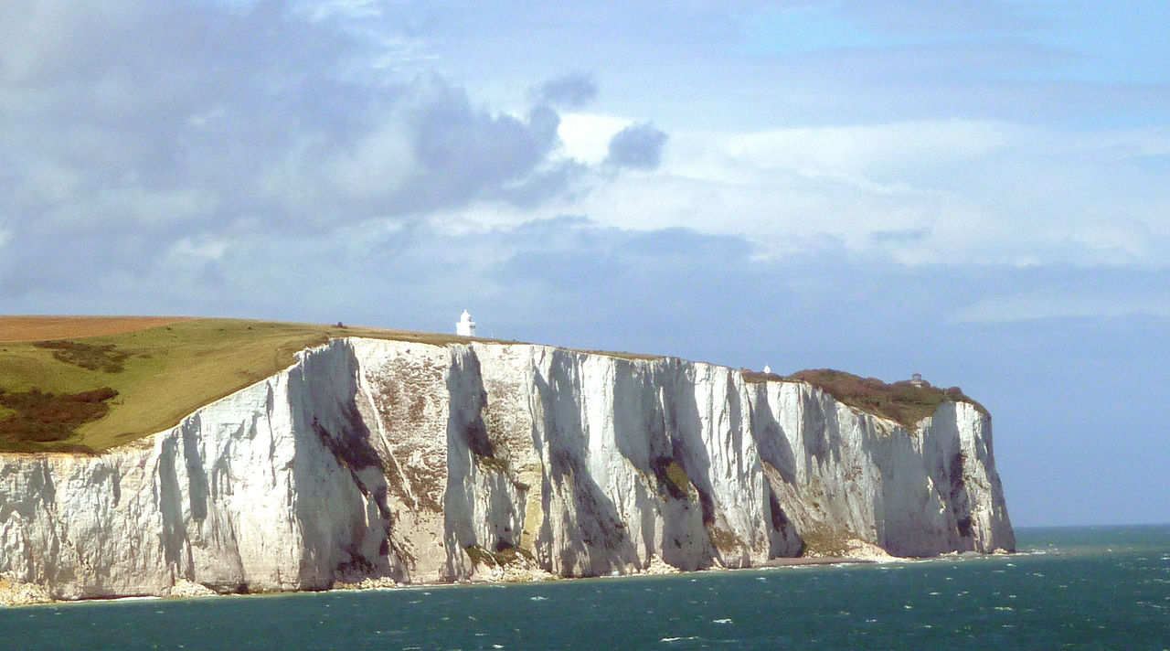
Marine Snow
Coccoliths form chalk and limestone
Major Carbon Sink!
By Immanuel Giel - Own work, CC BY-SA 3.0, https://commons.wikimedia.org/w/index.php?curid=25365041

Slide 46

Plankton species depend on water chemistry depends on plate tectonics
Aragonite seas - High Mg/Ca
Calcite seas - Low Mg/Ca
Different algae dominate depending on seawater composition
High tectonic activity = Calcite

Slide 47

Marine Snow – not only algae
Formanifera – (mainly) marine protists
Many form CaCO₃ shells
Elaborate structures – easy to identify
Can be used to age rocks (used in oil exploration)

Slide 48

Marine Snow
Oil deposits arise from plankton
Anaerobic conditions – partial decay of biological materials

Slide 50
Algae and the Carbon cycle

Slide 51

Phytoplankton and the global carbon cycle
~50% global carbon fixation is due to phytoplankton
Plankton form the basis of all marine food webs
Major driver of ocean carbon cycle
CO2_pump_hg.png, CC BY-SA 2.5, https://commons.wikimedia.org/w/index.php?curid=4956173
See: https://learningonscreen.ac.uk/ondemand/index.php/clip/101209 (4mins)

Slide 52

Phytoplankton and the global carbon cycle
Why don’t phytoplankton grow everywhere?
Notes:
See also: https://earthobservatory.nasa.gov/GlobalMaps/view.php?d1=MY1DMM_CHLORA

Slide 53

El Niño
Reversal of normal ocean currents in South Pacific
Causes droughts in S.E Asia and storms in S. America
Stops cold waters from rising on S. America coast
Fish die
Why?

Slide 54

High Nutrient – Low Chlorophyll (HNLC) regions
https://commons.wikimedia.org/wiki/File%3ACwall99_lg.jpg
Most nutrients present in large quantities – but few phytoplankton
Limited by IRON
Fe needed for growth, especially photosynthesis
Fe³⁺ insoluble – results from OXIDATION

